Slide 1
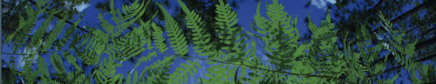

R-based Data Downloads
Shelly Gaynor
University of Florida

Slide 2
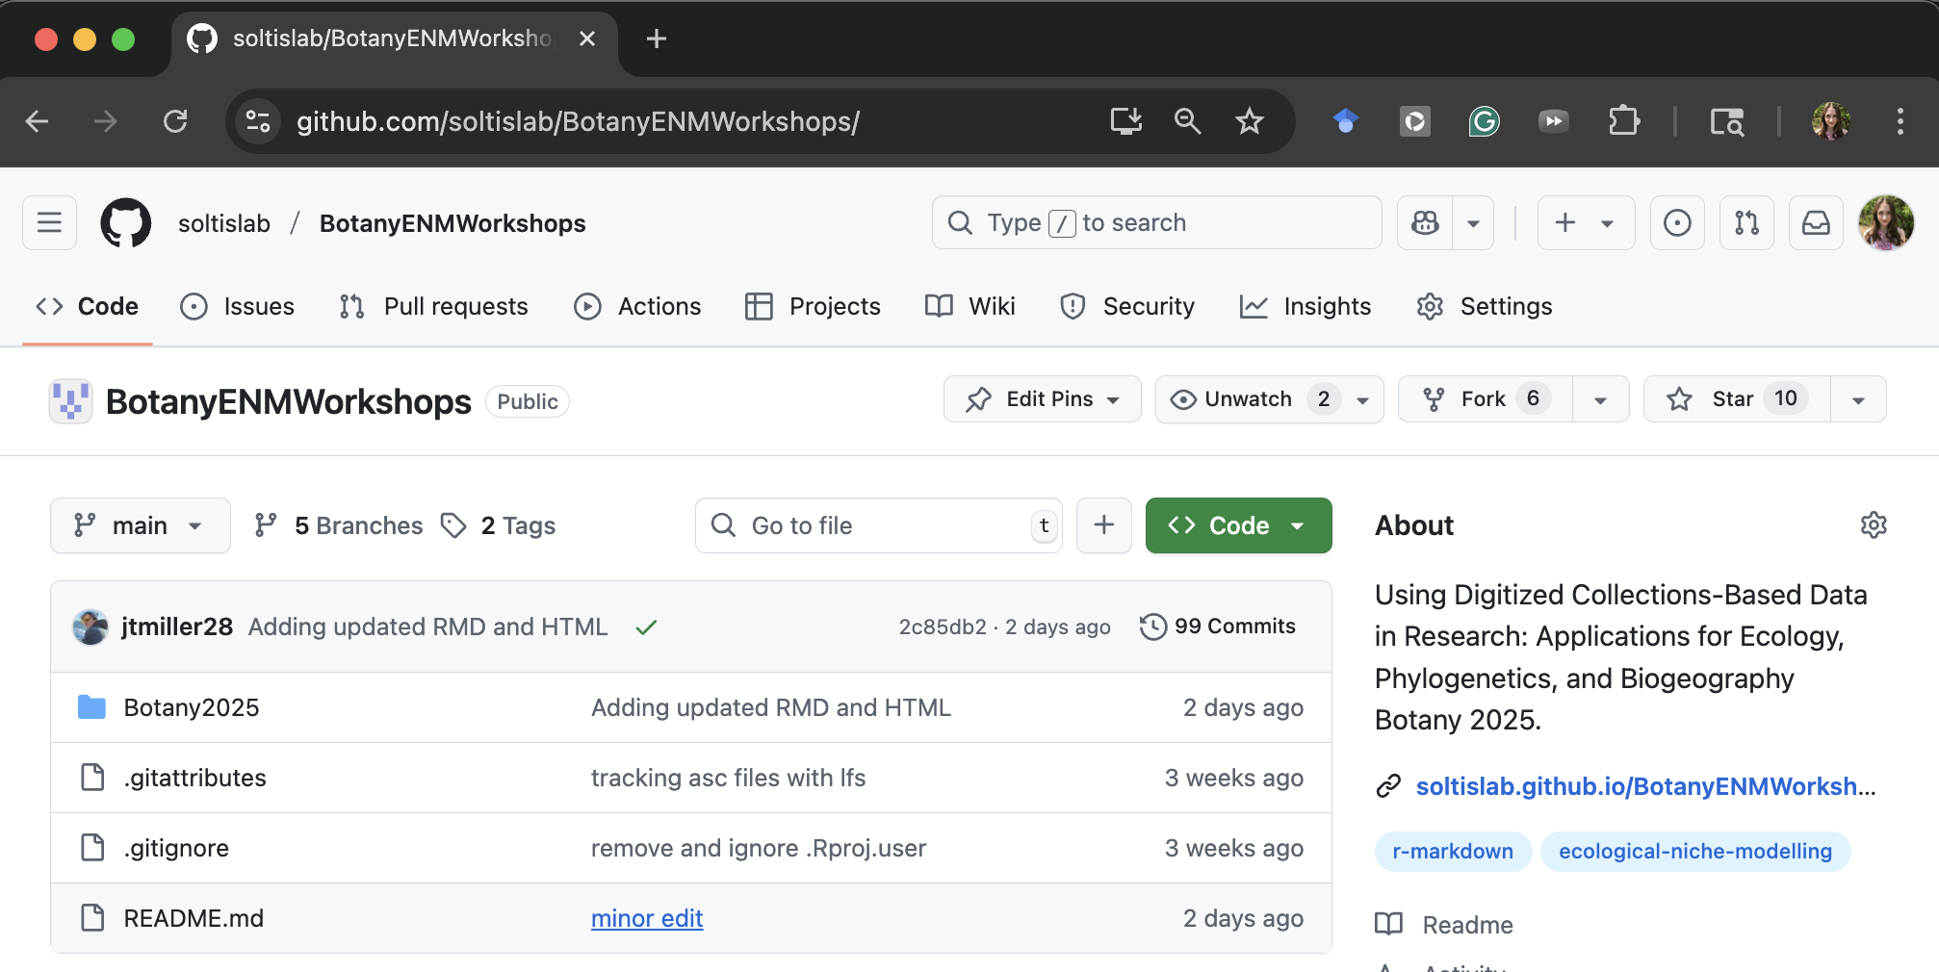
Github: soltislab/BotanyENMWorkshop/
See the code: https://tinyurl.com/bworksho

Slide 3
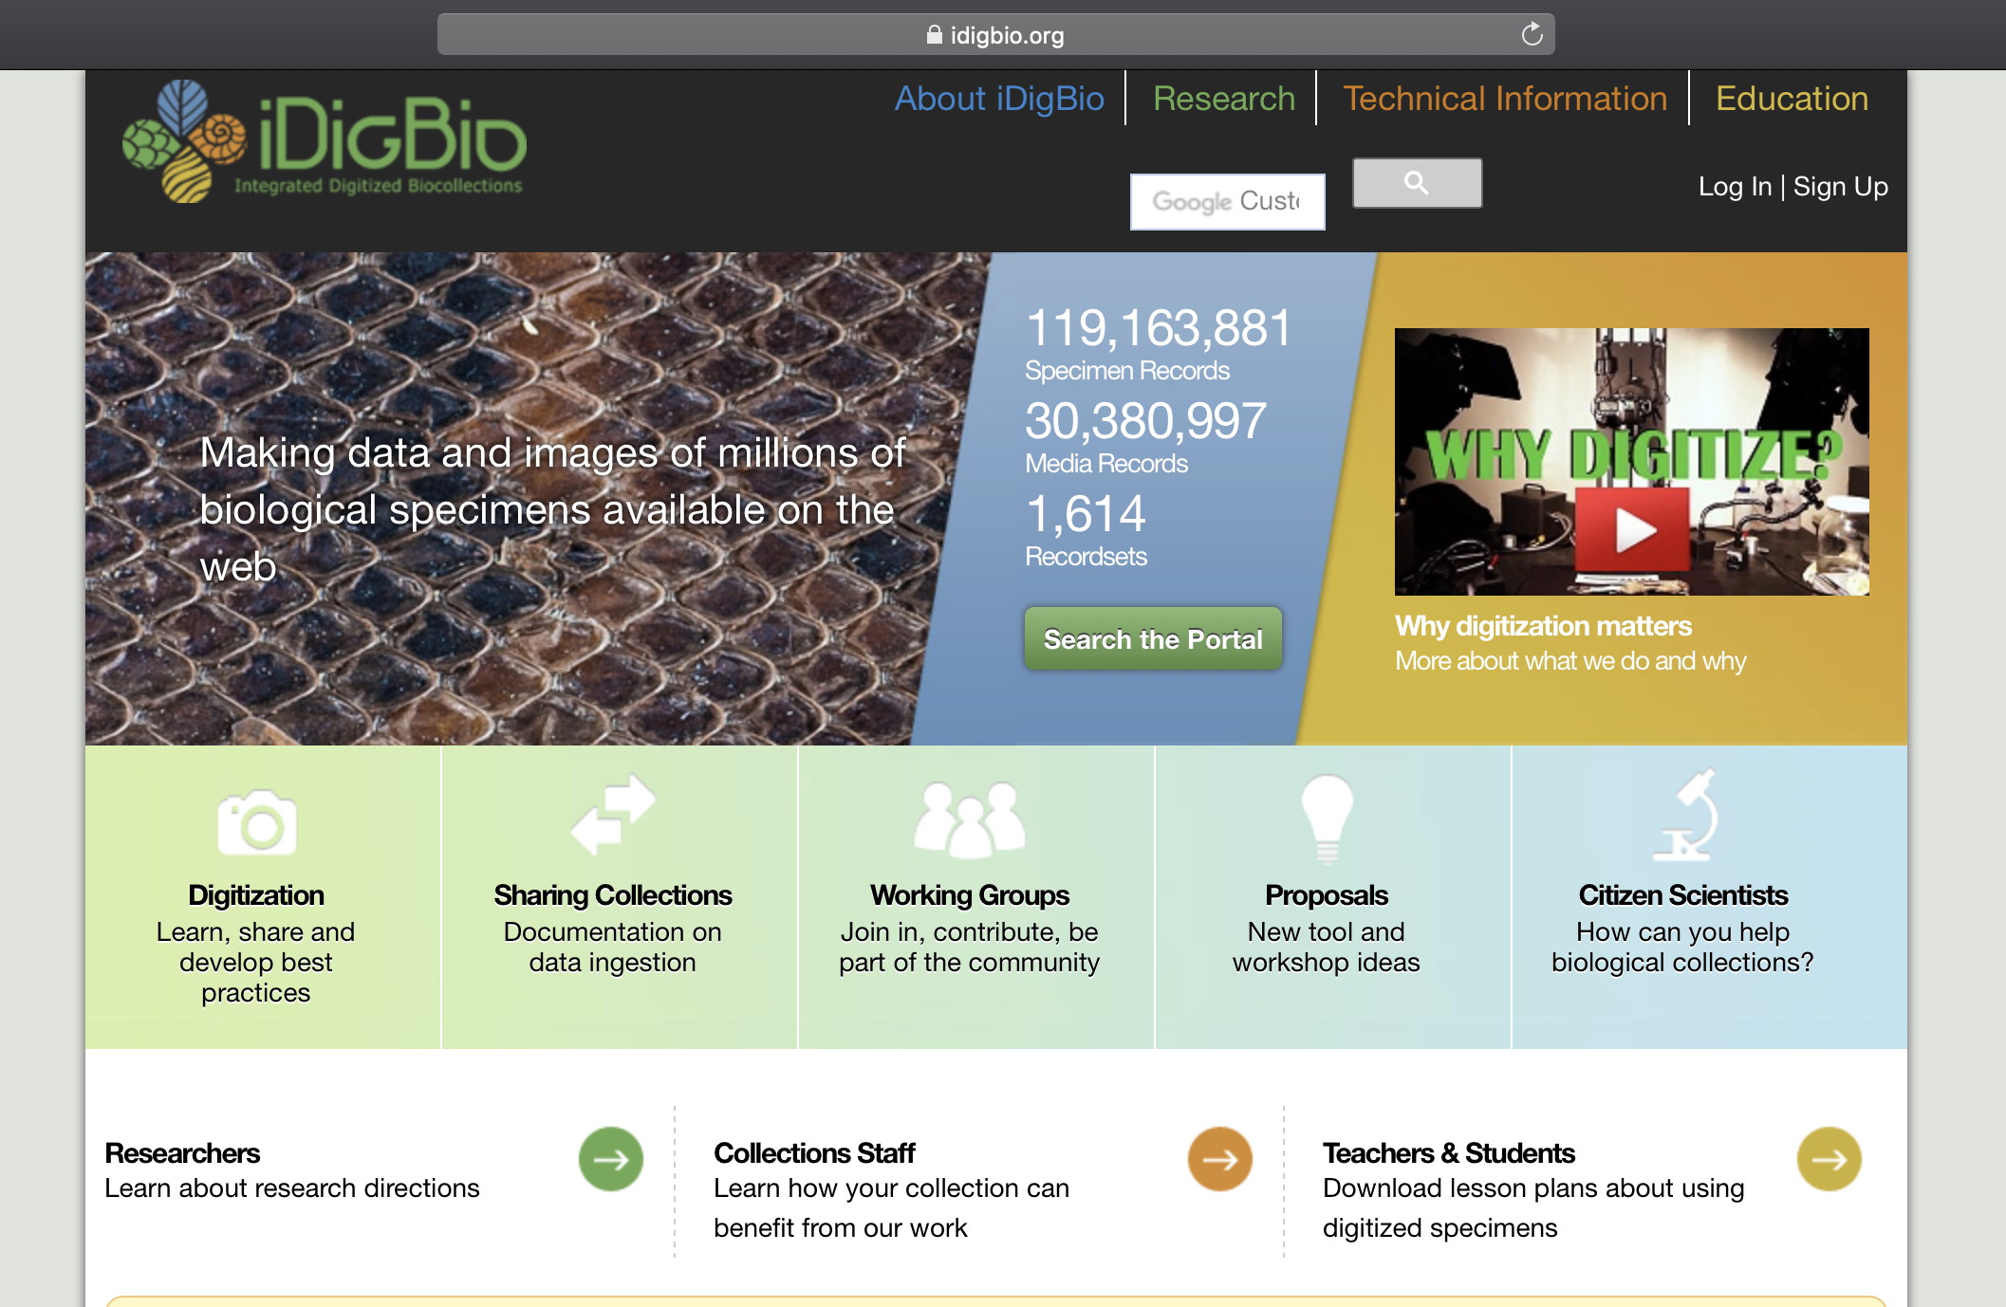


API = Application Programming Interface
Allows users to interact with a system
Web portal
API
Database
Interface

Slide 4
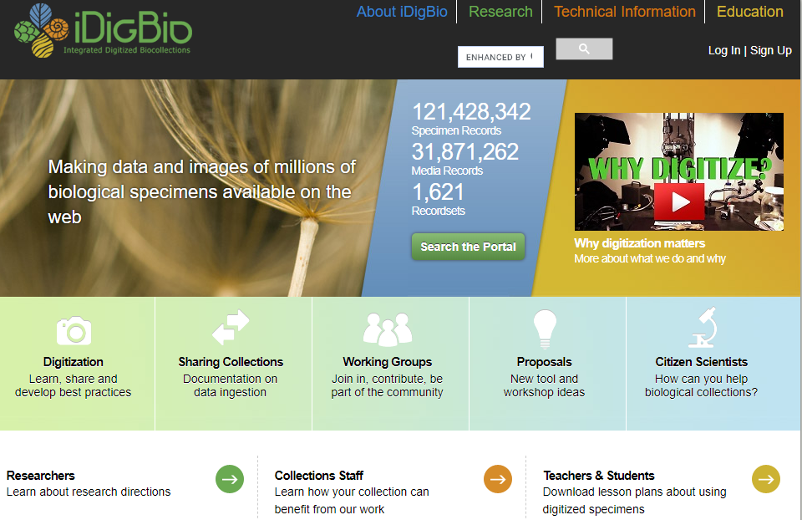

Slide 5

iDigBio API
Multiple ways to access the API:
API Name | Info
Search API | ridigbio R package <100,000 records
Download API | >100,000 records
Record API | Single record
Media API | Single record
biodiversity-specimen-data/specimen-data-use-case

Slide 6
iDigBio API
Multiple ways to access the API:
API Name | Info
Search API | ridigbio R package <100,000 records
Download API | >100,000 records
Record API | Single record
Media API | Single record
biodiversity-specimen-data/specimen-data-use-case

Slide 7

GBIF API
Multiple ways to access the API:
API Name | Info
Registry API | Create, edit, update and search for information about datasets
Species API | Taxonomy API
Occurrence API | Record API
Maps API | Show maps of GBIF
News API | Search papers published using GBIF
https://www.gbif.org/developer/summary

Slide 8
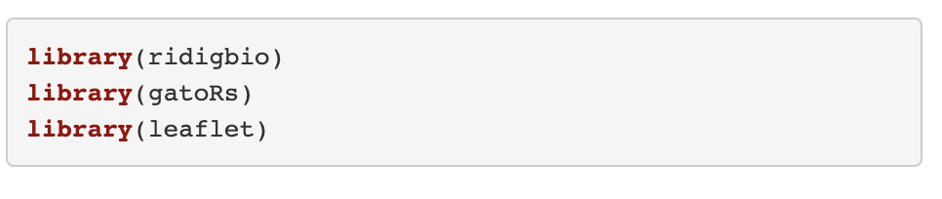



Load Packages
Notes:
spocc- Global Biodiversity Information Facility ('GBIF'), 'USGSs' Biodiversity Information Serving Our Nation ('BISON'), 'iNaturalist', Berkeley 'Ecoinformatics' Engine, 'eBird', Integrated Digitized 'Biocollections' ('iDigBio'), 'VertNet', Ocean 'Biogeographic' Information System ('OBIS'), and Atlas of Living Australia ('ALA'). Includes functionality for retrieving species occurrence data, and combining those data.
Ridigbio-Interface to the iDigBio Data API

Slide 9
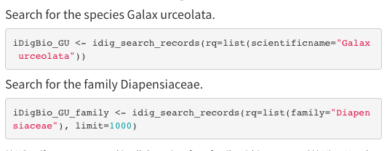
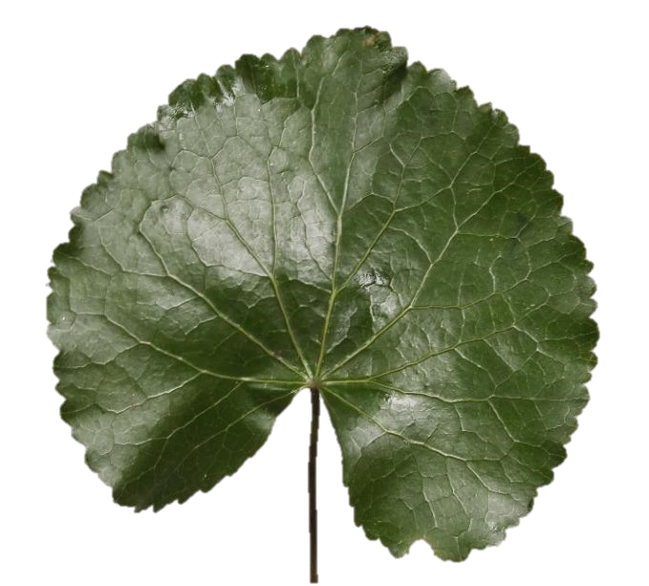
Downloading data using ridigbio
First, we are searching for the species Galax urceolata
Next, download occurrence records for the family Diapensiaceae

Slide 10
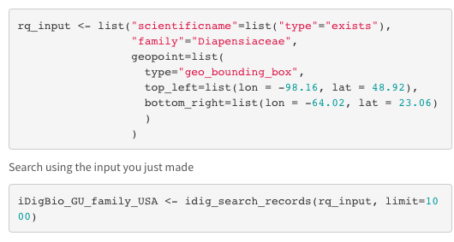
Records only in North America

Slide 11
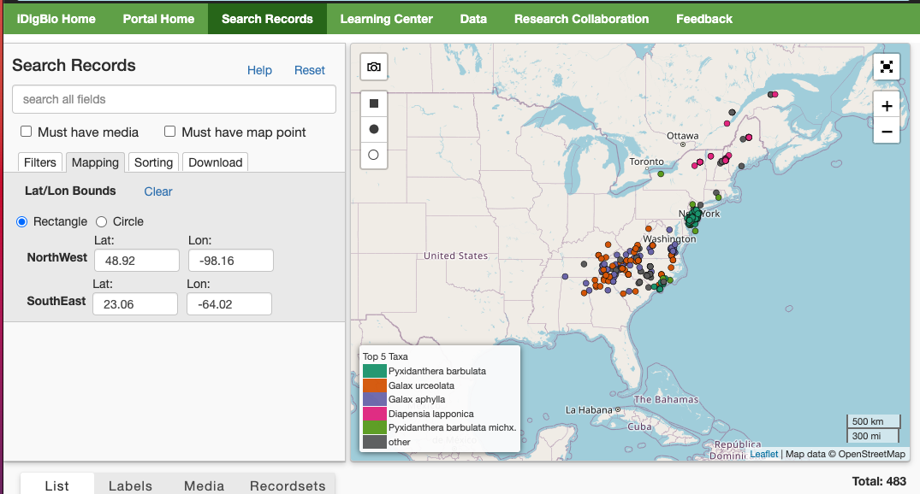

Slide 12
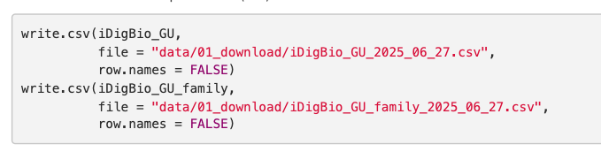
Save as csv

Slide 13




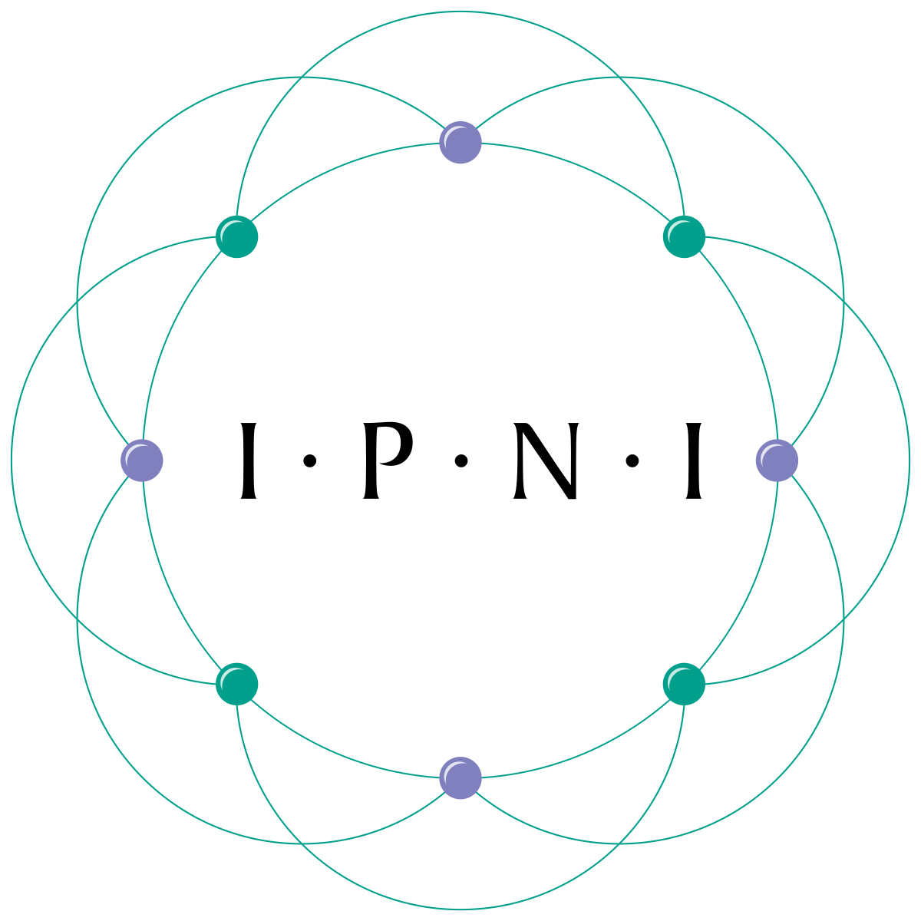


Data download using gatoRs
To pull data from GBIF and iDigBio for a set of synonyms
Identifying synonyms:
Taxonomic Name Resolution Service
https://tnrs.biendata.org/
Used in soltislab/BotanyENMWorkshops 2020
R package taxize
20 sources for synonyms
https://docs.ropensci.org/taxize/
Natalie Patten

Slide 14
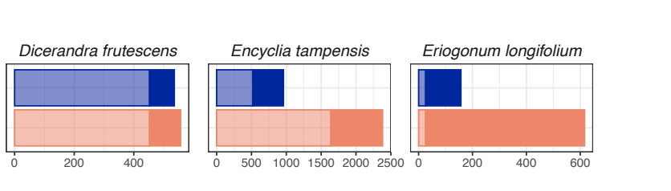

Why should I use gatoRs?
GBIF
iDigBio
Downloaded Records
Patten et al. 2024. Applications in Plant Science.

Slide 15
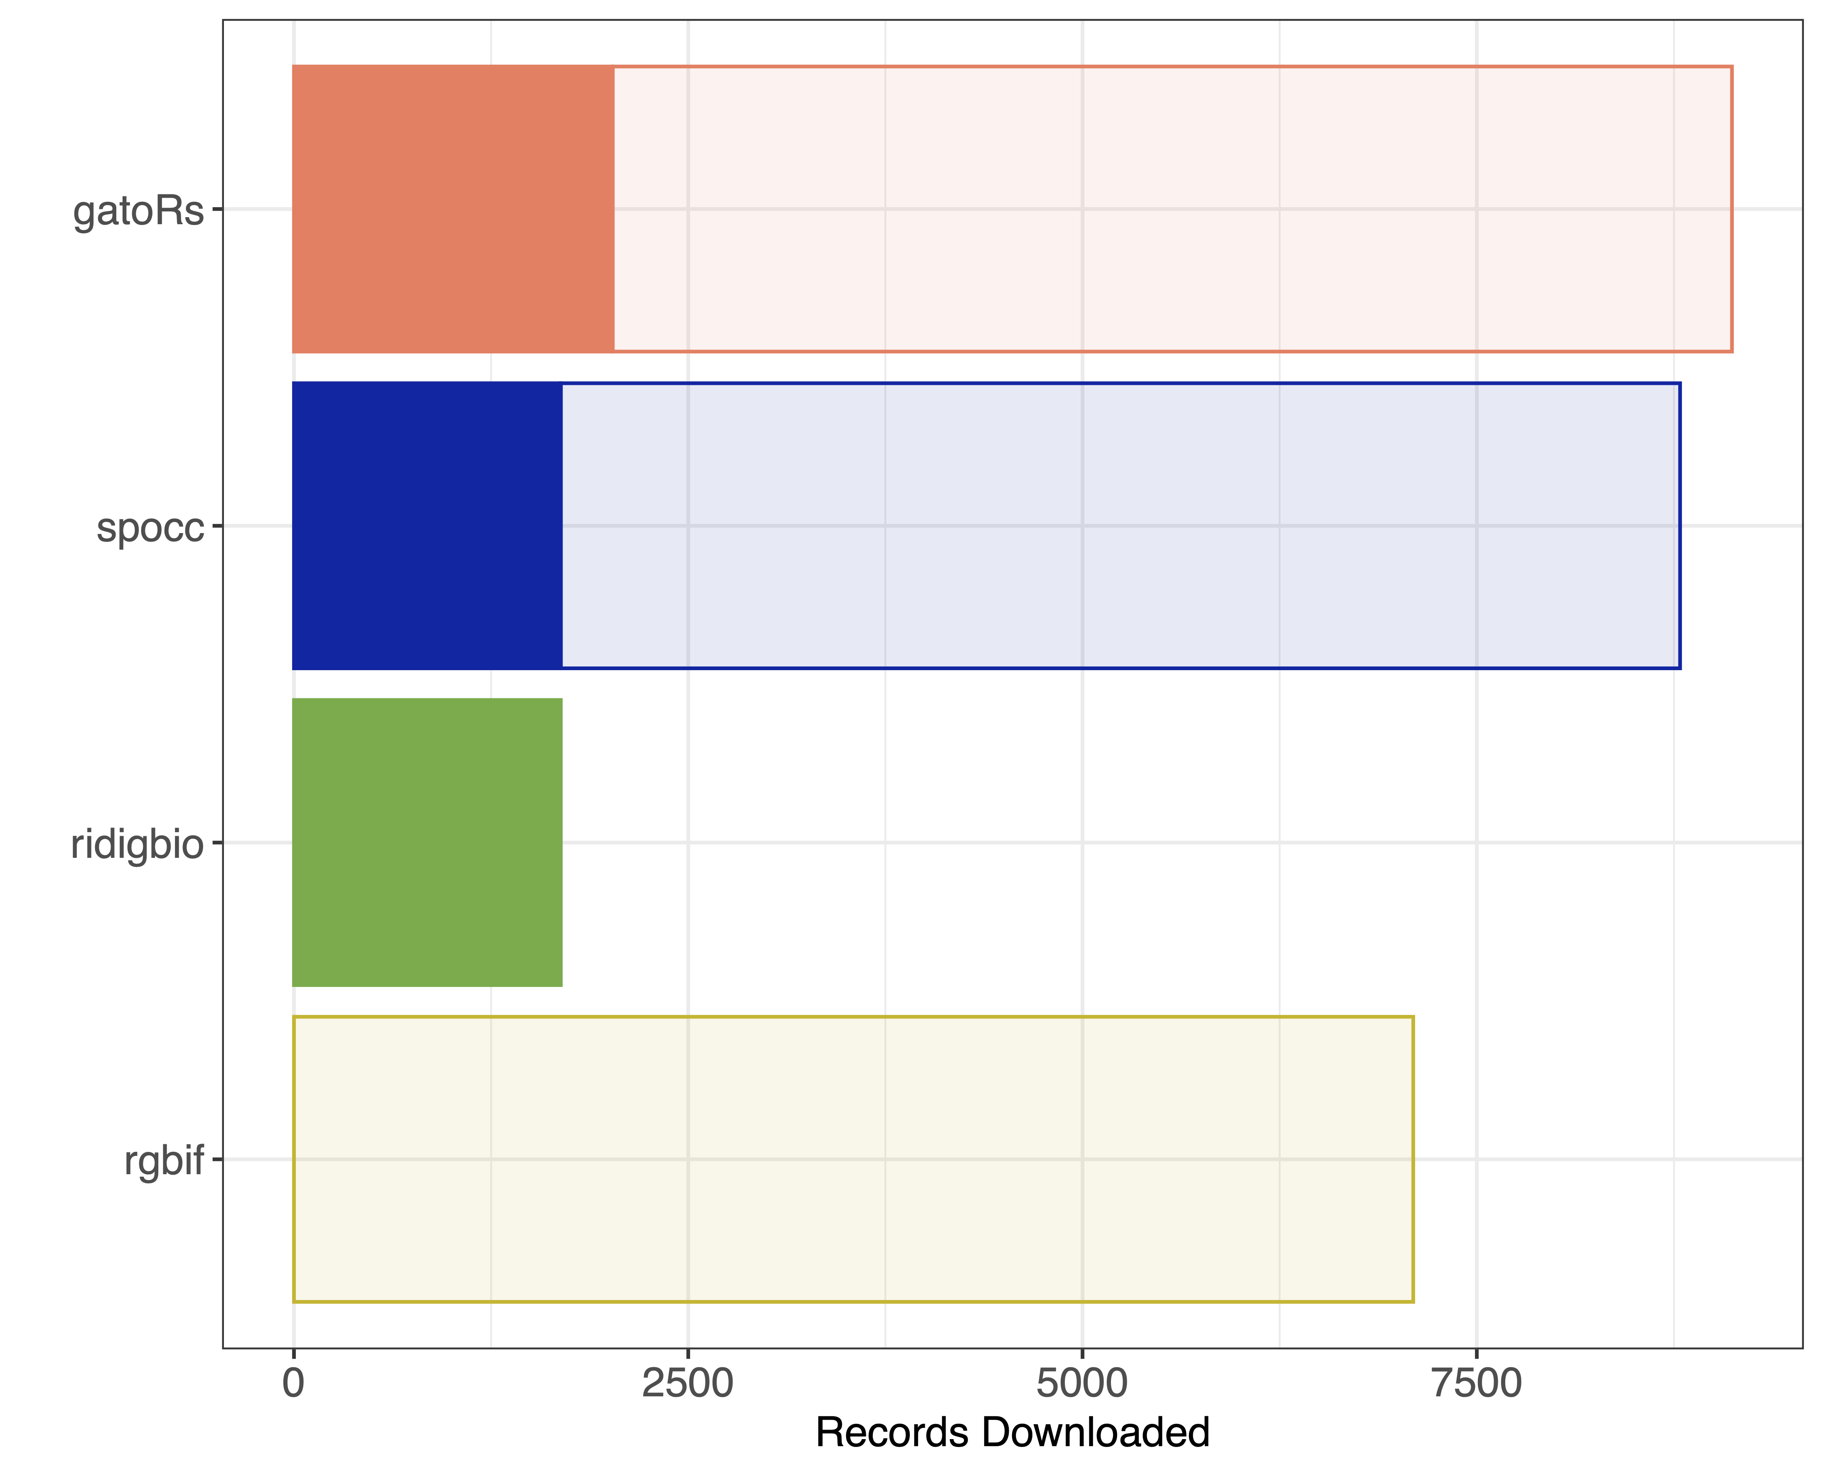
iDigBio
GBIF
iDigBio
GBIF
Galax urceolata
https://mlgaynor.com/DEMO-Gaynor-2024/Gaynor-DEMO01.html

Slide 16
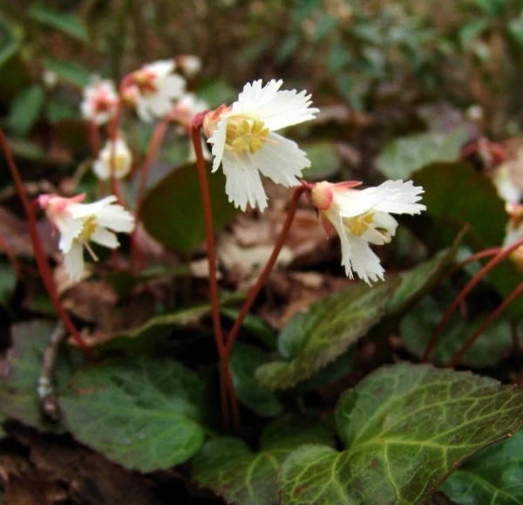
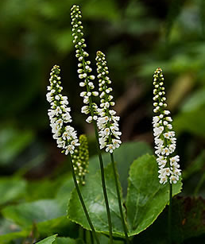
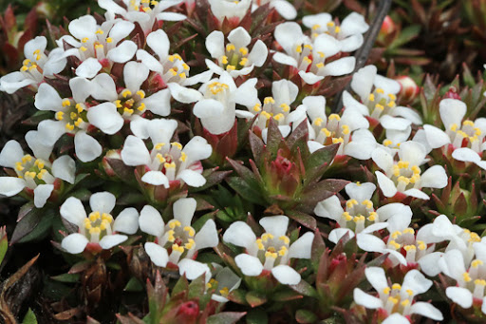
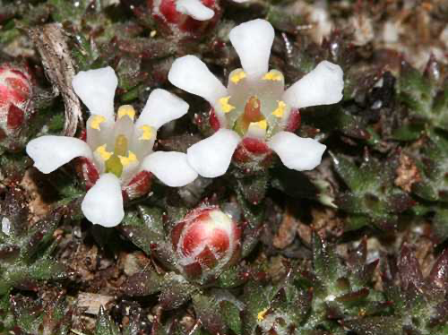
Shortia galacifolia
Galax urceolata
Pyxidanthera barbulata
Pyxidanthera brevifolia
Diapensiaceae
Ericales

Slide 17
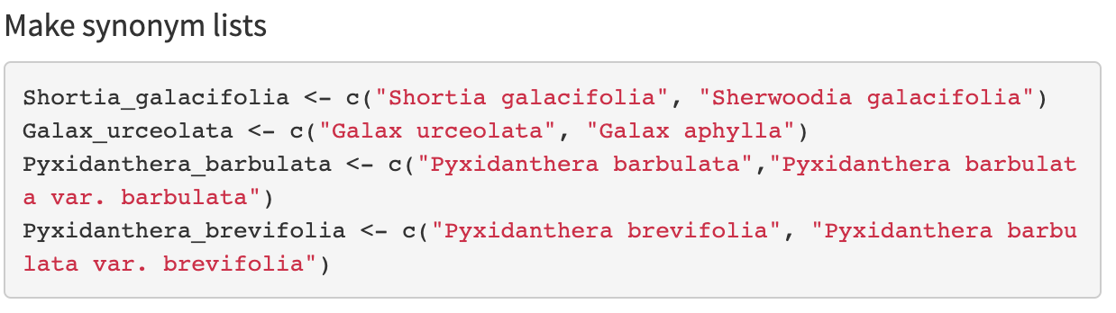
Data download using gator_download
Object
List of strings

Slide 18
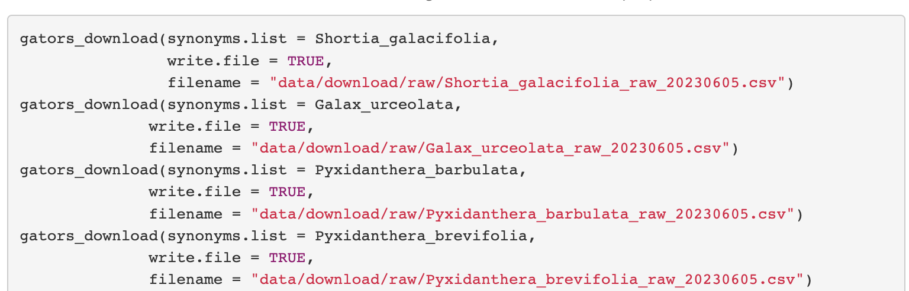
Data download using gators_download
,
Synonym list
Save csv file

Slide 19
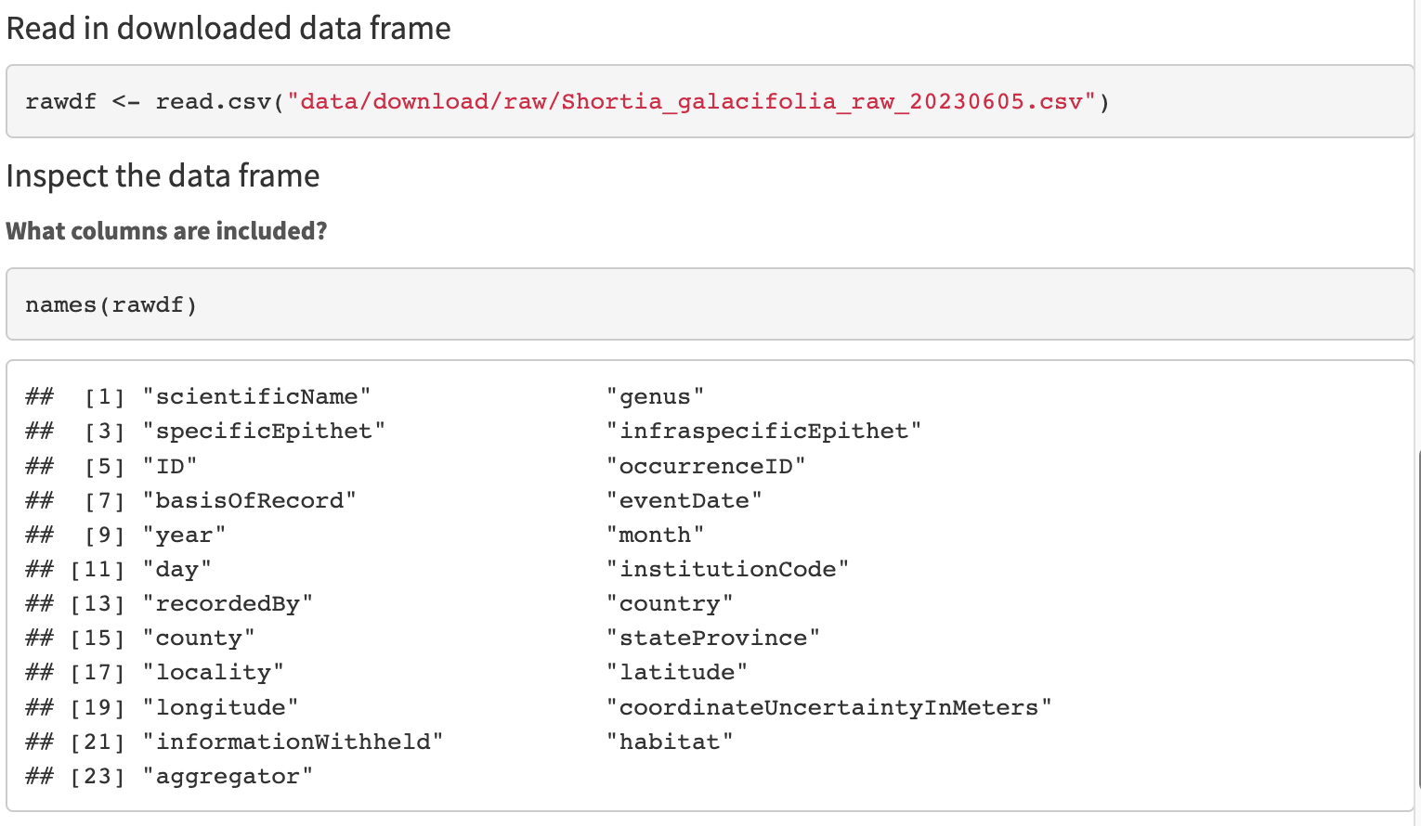
Quick-look at downloaded files

Slide 20
